Slide 1


Import, Export, and transfer data with Navicat
Navicat Certified Database Administrator - Associate

Slide 2

HKIIT - Navicat Certified Database Administrator - Associate
Lessons Intended Learning Outcome
On completion of this lesson(s), students are expected to be able to:
(#1).Import and export data using a variety of formats, such as Excel files, .csv, and . sql
(#2) Manipulate big chunks of data using Navicat's tools
(#3) Direct data transfer between different databases
(#4) Synchronize data and structure

Slide 3
HKIIT - Navicat Certified Database Administrator - Associate
Learning Outline
Importing database archive by using SQL dump files.
Exporting an entire database in to SQL dump files
Synchronize data and structure

Slide 4

DATA
Data Import, Export and Transfer
Scenarios:
Backups: Regular backups are vital for data recovery in case of hardware failure, data corruption, or accidental deletion.
Migrations: Moving data from one server to another, or upgrading to a new database version, requires reliable data transfer methods.
Data Sharing: Sharing data between different systems or departments often involves exporting and importing data.
Disaster Recovery: In the event of a disaster, having a robust data export and import strategy ensures that data can be quickly restored to minimize downtime.
HKIIT - Navicat Certified Database Administrator - Associate

Slide 5
DATA
Data Import, Export and Transfer
Maintaining data integrity and availability
Maintaining the health and performance of databases
Enabling seamless data migration
Ensuring business continuity
HKIIT - Navicat Certified Database Administrator - Associate

Slide 6
HKIIT - Navicat Certified Database Administrator - Associate
DATA IMPORT
Creating the database schema from a SQL dump file
In this section, we'll work with an existing sample database called Sakila.
Sakila is an example of a movie database, it serves to highlight the features of MySQL, including views, stored procedures, and triggers.
You can also download it from http://dev.mysql.com/doc/index-other.html
MySQL :: Other MySQL Documentation

Slide 7
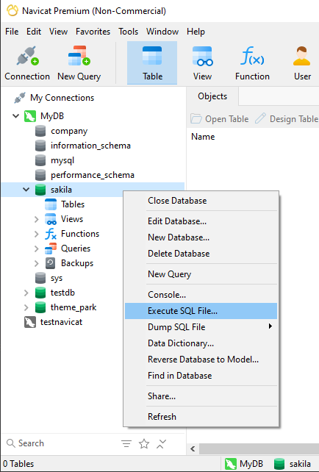
DATABASE
Get Sakila schema and data on your server
Connect to your database sever
Create a database named 'sakila’
Double click on the sakila database to use it
Right click on sakila database and select ‘Execute SQL file’
HKIIT - Navicat Certified Database Administrator - Associate

Slide 8
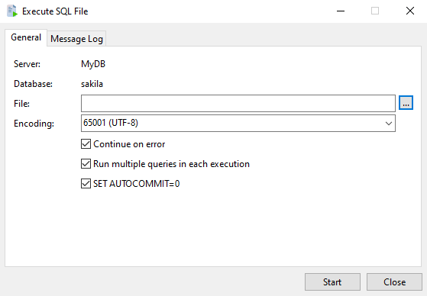
DATABASE
Execute SQL File Window
Under the General tab, you’ll see a field labeled File. Click the small, square-shaped button at the right end of this field to select your SQL file, such as sakila-schema.sql.
Ensure the settings match what you see in the screenshot, especially the Encoding, which should be set to 65001 (UTF-8).
HKIIT - Navicat Certified Database Administrator - Associate

Slide 9
DATABASE
Execute SQL File Window
Optional: Continue on Error:
You can uncheck the Continue on error option to ensure the process stops if any errors occur. This way, you can correct any issues before proceeding.
If you leave this option checked, the process will continue even if errors occur. You can then refer to the Message Log under the second tab to review any errors and take necessary actions.
HKIIT - Navicat Certified Database Administrator - Associate

Slide 10
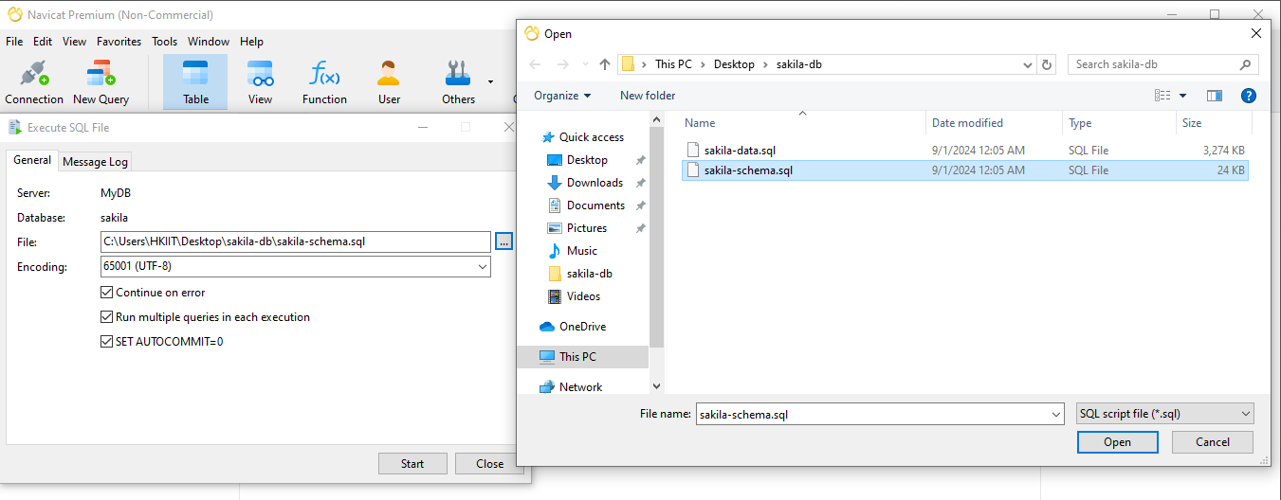
DATABASE
Get Sakila schema and data on your server
HKIIT - Navicat Certified Database Administrator - Associate

Slide 11
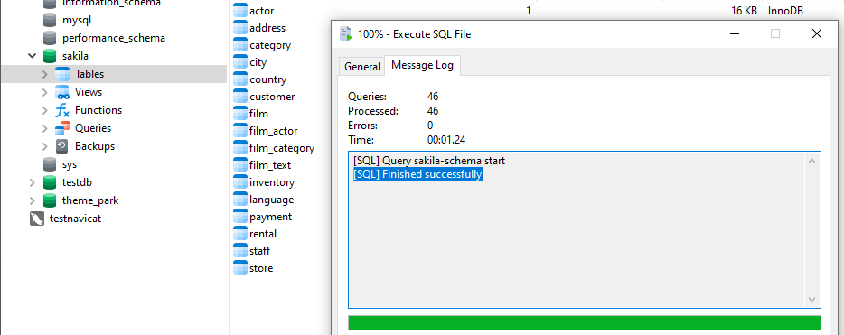
DATABASE
Get Sakila schema and data on your server
By following these steps, you should be able to successfully import your database from an SQL dump file.
HKIIT - Navicat Certified Database Administrator - Associate

Slide 12
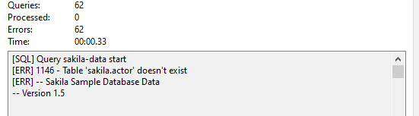
DATABASE
Get Sakila schema and data on your server
If any errors occur, you can easily identify and fix them by checking the settings and referring to the Message Log.
HKIIT - Navicat Certified Database Administrator - Associate

Slide 13
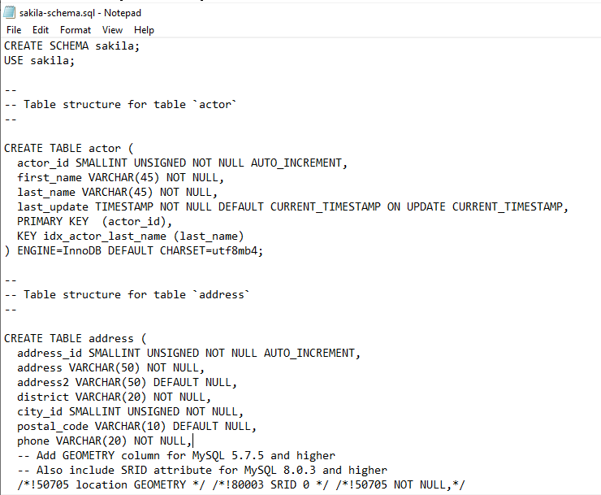
DATABASE
SQL dump file
An SQL dump file typically contains a series of SQL commands that are used to create and populate a database.
By running the sakila-schema.sql file, you set up the foundational structure of the Sakila database, ready to be populated with data.
HKIIT - Navicat Certified Database Administrator - Associate

Slide 14
HKIIT - Navicat Certified Database Administrator - Associate
DATA IMPORT
Importing and exporting data
In this section, we'll cover import/ export capabilities of Navicat in more detail.
We will use Navicat to export all schema and data from an existing database, in a SQL dump files. The SQL dump file can be used to regenerated on another MySQL server or as another instance of the database on the same server.

Slide 15
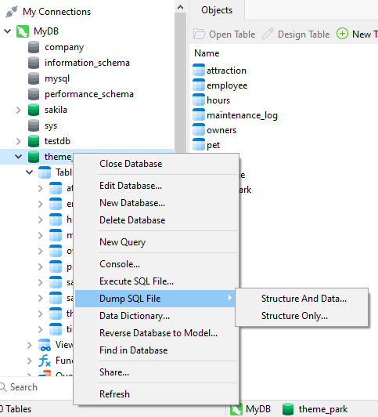
DATABASE
One Step to Export an Entire Database
1. Right-click on target DB
2. Choose Dump SQL file from the pop-up menu.
HKIIT - Navicat Certified Database Administrator - Associate

Slide 16
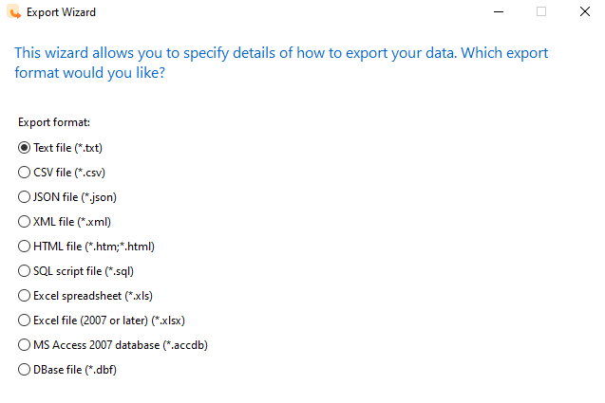
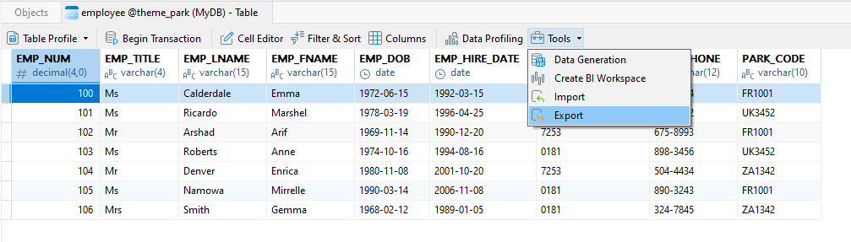

DATABASE
Export data to a variety of formats
If you’re working as a database administrator or an IT analyst, you might often need to export data from a database to share with clients or colleagues.
Navicat’s Export Wizard
HKIIT - Navicat Certified Database Administrator - Associate

Slide 17
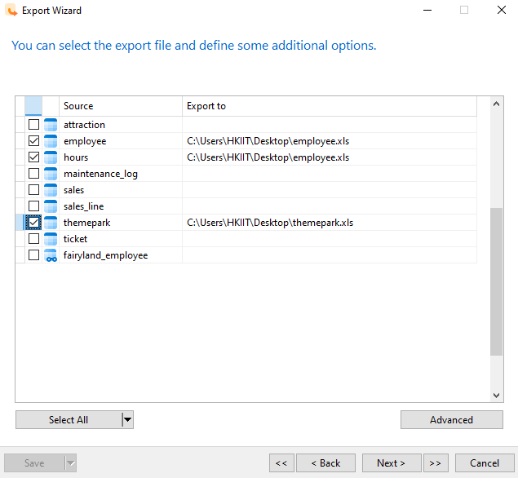
DATABASE
Exporting in detail
Navicat allows you to export multiple tables into a single file by specifying the same filename for each table.
For example, if you choose to export two or more tables to a single Excel file ( . xlsx), each will be a separate spreadsheet in the same file.
HKIIT - Navicat Certified Database Administrator - Associate

Slide 18
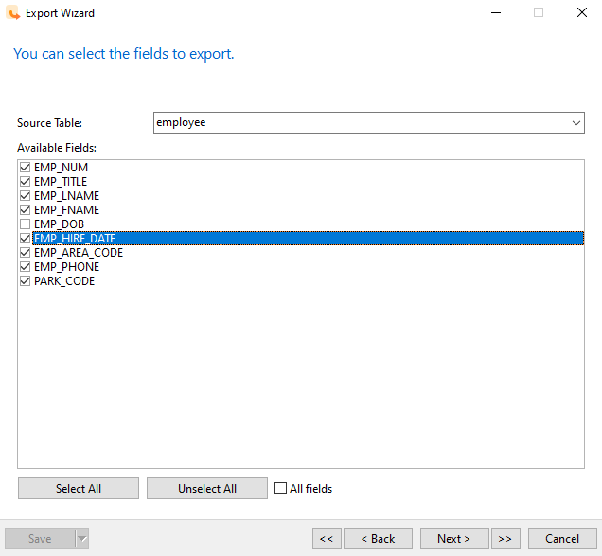
DATABASE
Exporting in detail
Selecting the columns (or fields) for exporting
HKIIT - Navicat Certified Database Administrator - Associate

Slide 19
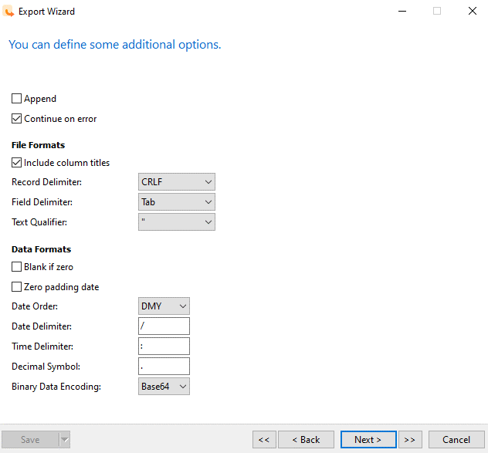
DATABASE
Exporting: Specify settings
Specify how data is arranged in the file
Row and Field delimiters, Text qualifiers, and the format for date, time, and numbers.
HKIIT - Navicat Certified Database Administrator - Associate

Slide 20
DATABASE
Delimiter
The record delimiter is the character that ends each record, and this will either be the carriage return/new line combination common on files created in Windows, a new line character, or a carriage return character.
The field delimiter is the character that delimits each field, in our case a comma, but also possibly a tab character, space or other symbol.
The text qualifier is a character, usually a single or double quotation mark, that may appear around complete field entries. This ensures that any delimiter characters that are contained within the field itself won’t be treated as field separators. The use of a text qualifier is common in csv files because it is common to have commas contained within text or numbers
HKIIT - Navicat Certified Database Administrator - Associate

Slide 21
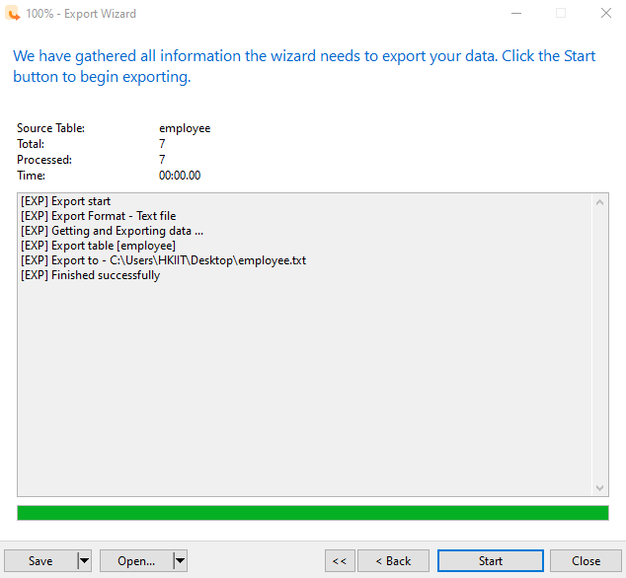
DATABASE
Exporting in detail
The exporting should be completed in a matter of seconds.
When the operation is complete, you can perceive it from the progress bar and the Message Log.
HKIIT - Navicat Certified Database Administrator - Associate

Slide 22
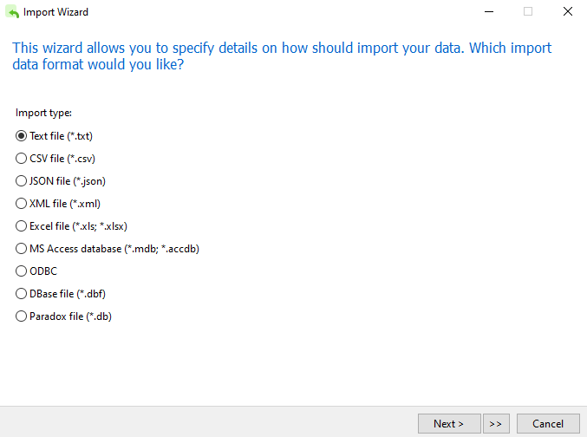
DATA IMPORT
Importing a file into a table
Just as you can export data from Navicat in various formats, you can also import data into a table using formats like Excel, XML, and CSV.
HKIIT - Navicat Certified Database Administrator - Associate

Slide 23
DATABASE
Common Scenario
A typical scenario might involve a business unit sending an Excel spreadsheet to the IT department, requesting an update to the corporate database.
However, column names in these spreadsheets can sometimes be inconsistent (e.g., SALES_REP might become SALES_PERSON or SALES_REP_NAME).
HKIIT - Navicat Certified Database Administrator - Associate

Slide 24
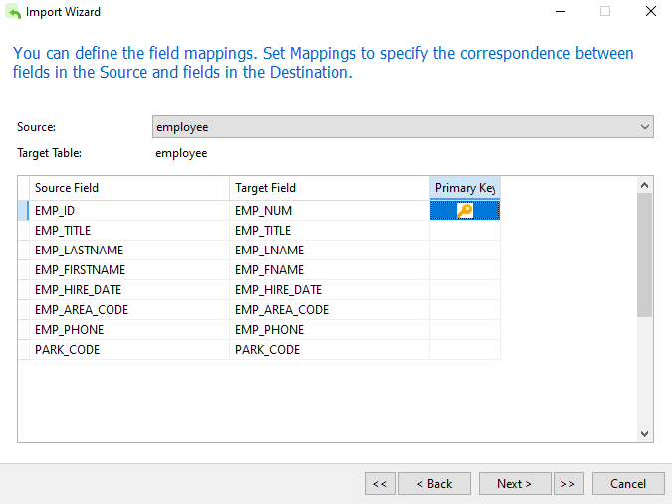
DATABASE
Dealing with inconsistent column names
Match Source Columns to Target Fields
HKIIT - Navicat Certified Database Administrator - Associate

Slide 25
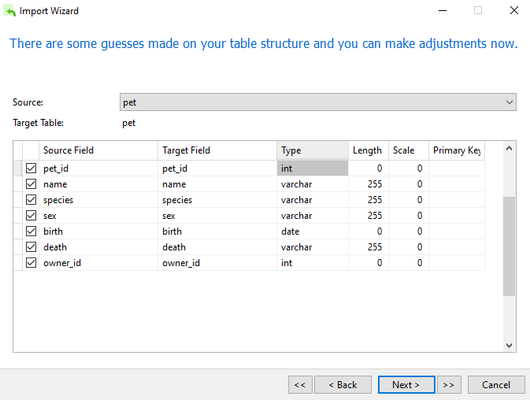
DATABASE
Import data to a new table
Navicat will automatically infer the datatype for each field based on the data it detects.
You can review these and make changes if necessary.
HKIIT - Navicat Certified Database Administrator - Associate

Slide 26
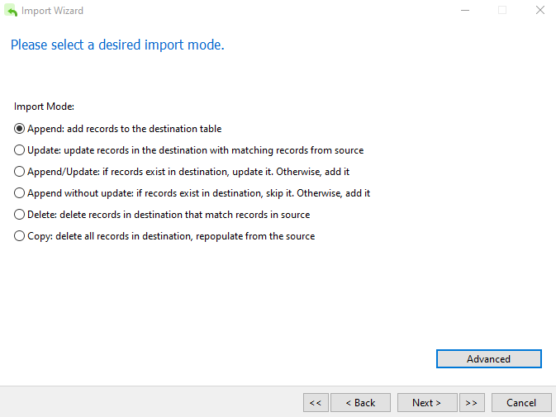
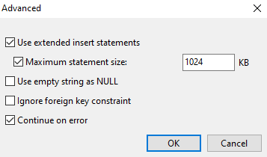
DATABASE
Import Mode
Advanced options:
You can change what is inserted if the import wizard encounters NULL (empty) values, and whether the import will continue if there is an error.
HKIIT - Navicat Certified Database Administrator - Associate

Slide 27

HKIIT - Navicat Certified Database Administrator - Associate
DATA MIGRATION
Migrating a database from one server to another is a common task for database administrators.
Navicat allows you to transfer database objects (such as Tables, Views, Functions, and Events) from one database to another, or to a SQL dump file. This can be done whether the target database is on the same server or a different one.

Slide 28
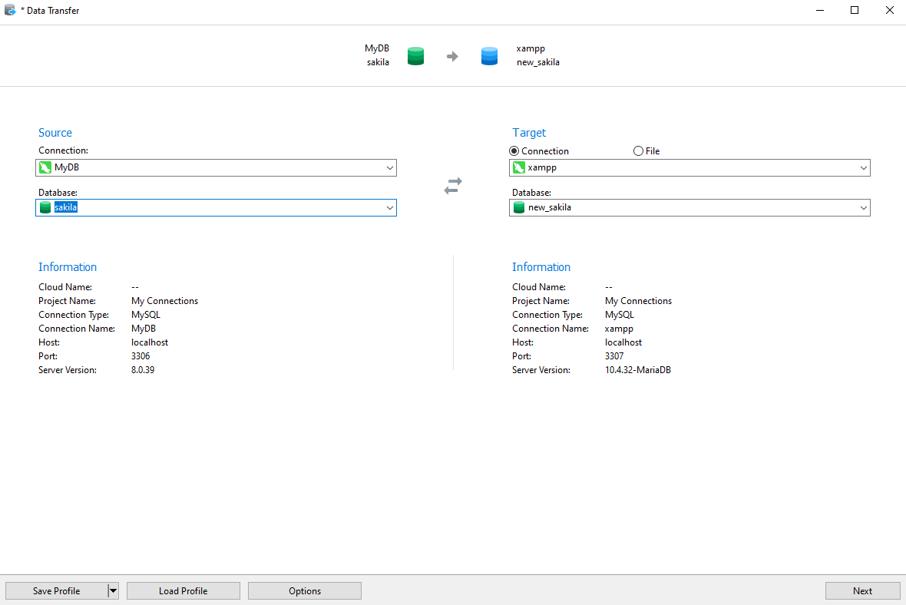
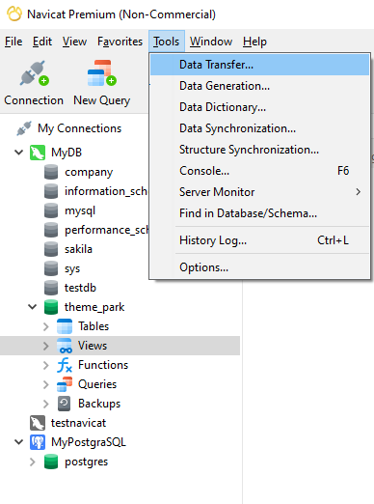
DATA MIGRATION
Migrating a database from one server to another
HKIIT - Navicat Certified Database Administrator - Associate

Slide 29
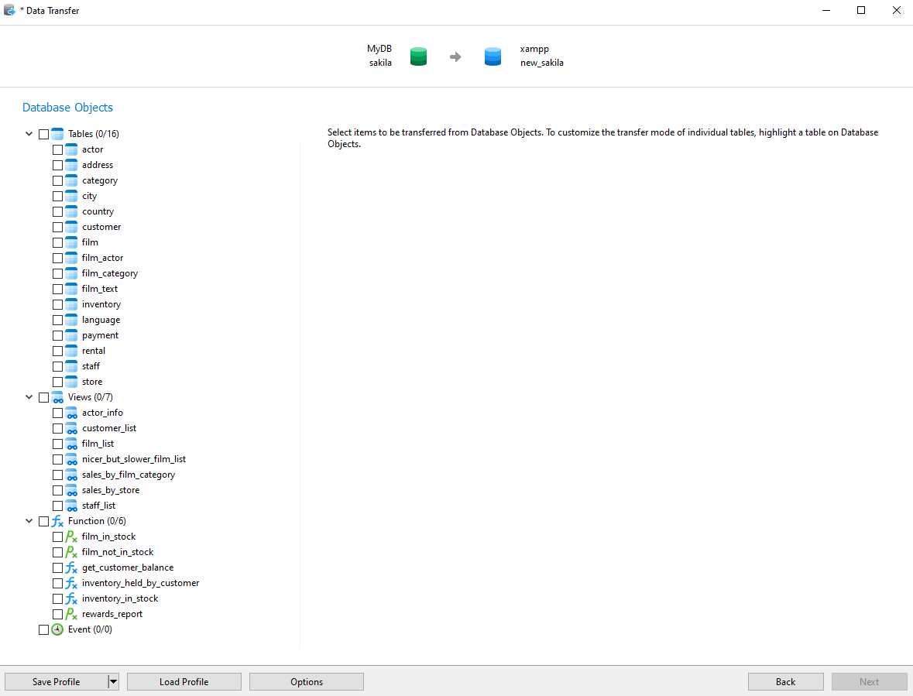
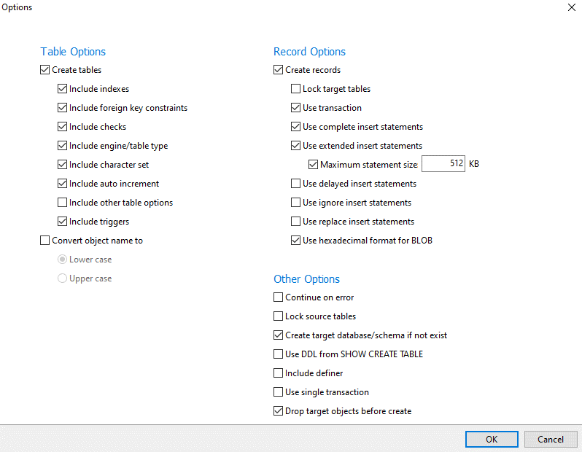
DATA MIGRATION
Migrating a database from one server to another
HKIIT - Navicat Certified Database Administrator - Associate

Slide 30
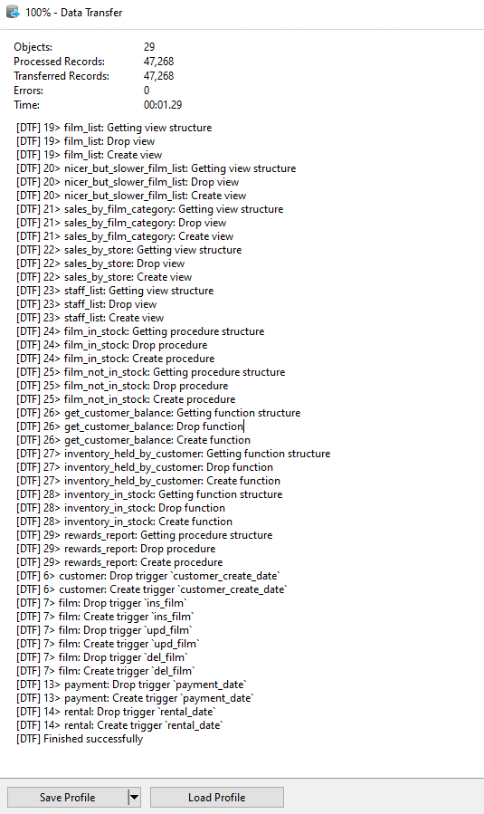
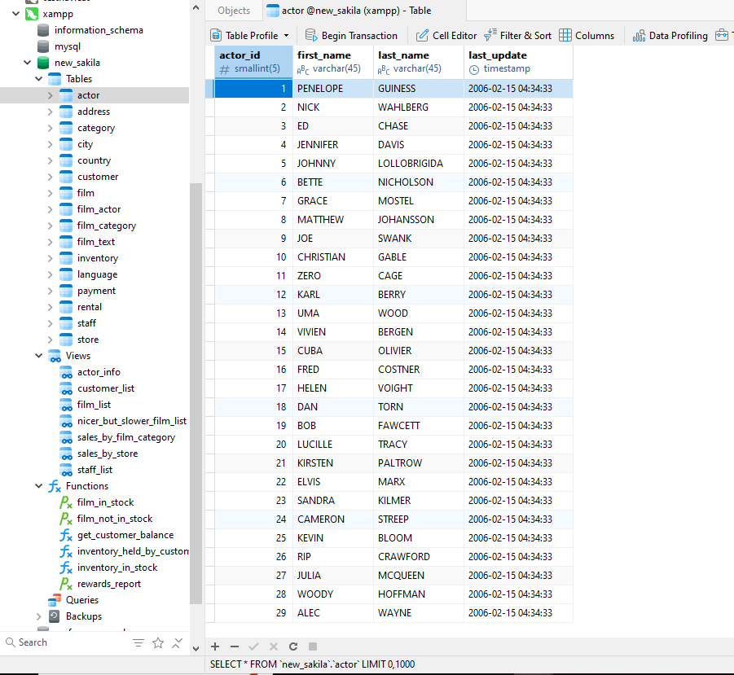
DATA MIGRATION
Migrating a database from one server to another
HKIIT - Navicat Certified Database Administrator - Associate

Slide 31
HKIIT - Navicat Certified Database Administrator - Associate
Synchronization
Data and Structure Synchronization with Navicat
When managing multiple instances of a database across different environments (development, testing, production), ensuring consistency can be challenging. Changes made in one environment often need to be replicated in others to avoid unexpected errors.
Synchronization tools could be useful is in cases where a previously performed data transfer operation is not successfully completed. The target database can be retouched using structure and data synchronization afterwards.

Slide 32
Synchronization
Migrating a database from one server to another
Structure Synchronization:
Synchronizes the schema (structure) of your databases, including tables, views, functions, and events.
Data Synchronization:
Synchronizes the actual data within your tables.
HKIIT - Navicat Certified Database Administrator - Associate

Slide 33
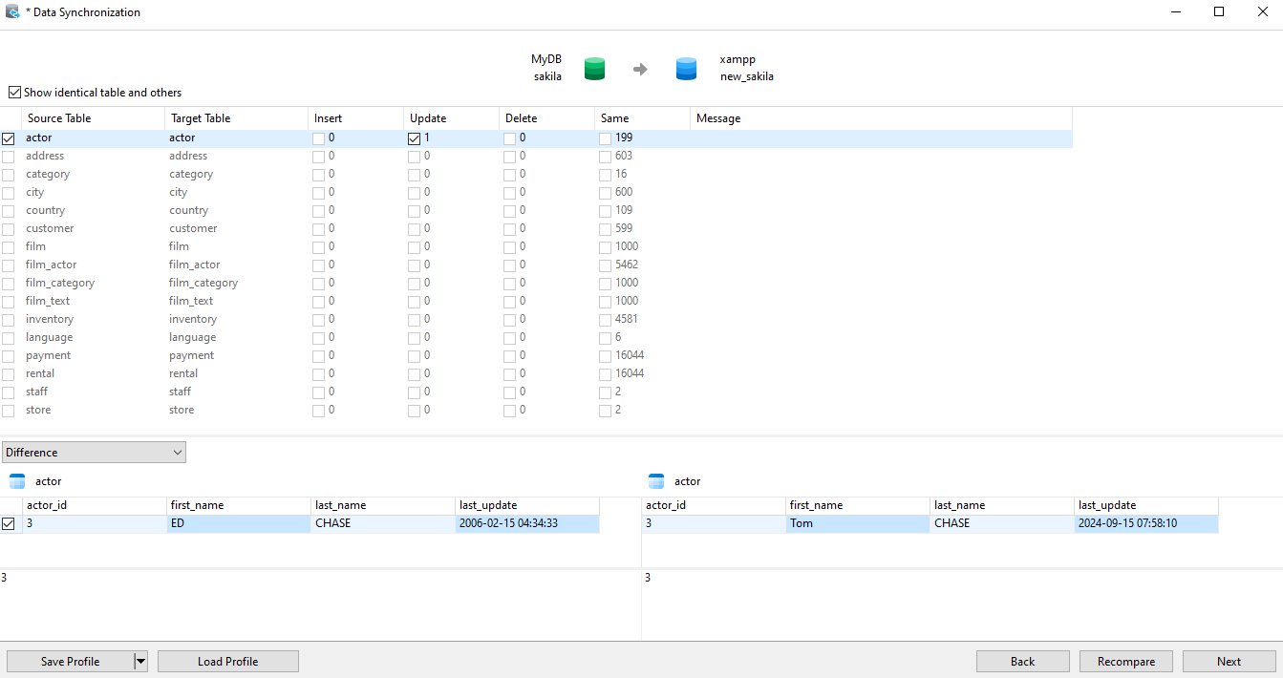
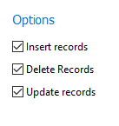
Synchronization
Data Synchronization
HKIIT - Navicat Certified Database Administrator - Associate

Slide 34
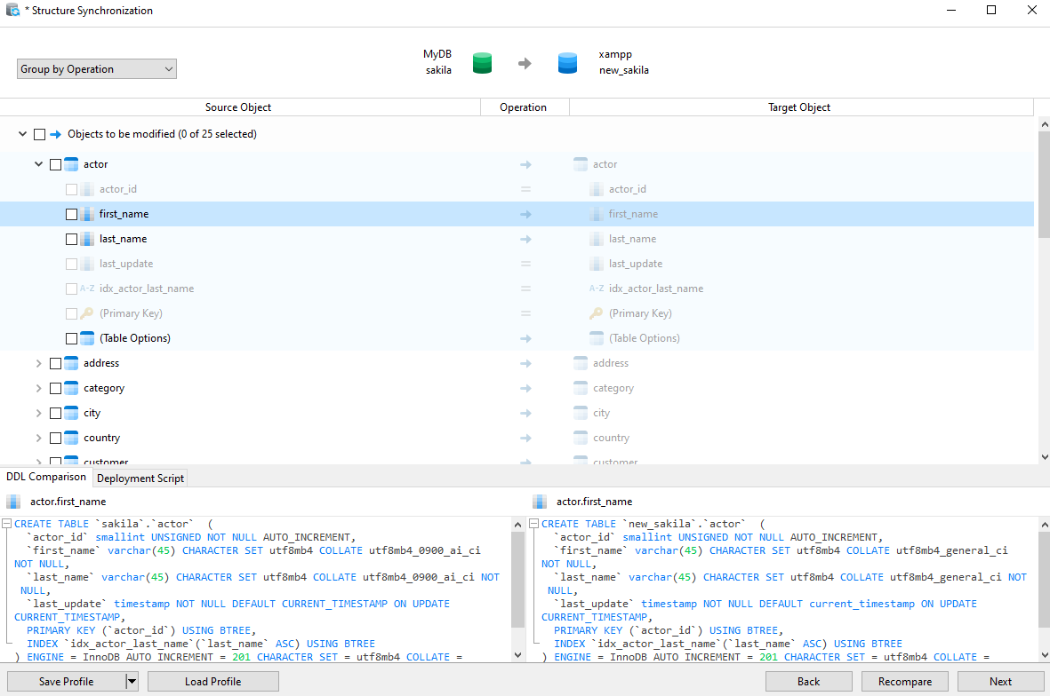
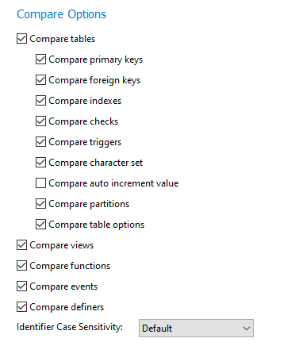
Synchronization
Structure Synchronization
HKIIT - Navicat Certified Database Administrator - Associate

Slide 35
DATABASE
Key Features of Synchronization Wizard
Detailed Comparison: Both wizards provide a detailed comparison of the source and target databases, allowing you to see exactly what will be changed.
Selective Synchronization: You can choose specific objects or data to synchronize, giving you full control over the process.
Advanced Options: Options like continuing on error and dropping target objects before creating new ones help manage complex synchronization tasks.
HKIIT - Navicat Certified Database Administrator - Associate

Slide 36

Navicat
Import, Export & Transfer Data
We have covered data management functionalities in Navicat, including importing and exporting data in formats like Excel, CSV, and SQL. We also learned how to manipulate large datasets, transfer data directly between different databases, and synchronize both data and structure efficiently.
HKIIT - Navicat Certified Database Administrator - Associate

